Slide 1

Analysis of Used Car Resale Prices using Web Scraping and Exploratory Data Analysis

Slide 2
About me
I am S.Vamsi Krishna from the Visakhapatnam. I completed my graduation in computer science and Engineering from the Vignan Institute of information technology.
I want to learn Data Science because AI is shaping the future, and Data Science forms the foundation of AI. I am deeply curious about how raw data is transformed into meaningful insights and intelligent systems. I see Data Science as a long-term career path that allows continuous learning, problem-solving, and the opportunity to work on real-world, impactful challenges.
LinkedIn : https://www.linkedin.com/in/surisetti-vamsikrishna-54627425a/
GITHUB : https://github.com/Vamsi-krishna17

Slide 3
Used Car Pricing & Valuation Problem
The project belongs to the Automobile Resale / Used Car Marketplace domain, where digital platforms like Cars24 enable individuals to buy and sell pre-owned vehicles online.
In this domain:
Each vehicle is physically tied to a city
Resale value depends on multiple vehicle attributes
Pricing is influenced by market demand, usage, and vehicle condition

Slide 4
Objective of the Project
The primary objective of this project is to analyze used-car resale listings from Cars24 to understand the key factors that influence vehicle resale prices across different Indian cities.
Specifically, this project aims to:
Study how vehicle age (year) and usage (km driven) impact resale value
Analyze the effect of fuel type and transmission on pricing
Compare city-wise pricing patterns in the used-car market

Slide 5
Web Scraping
We collected the data from the Cars24 website, which is an online platform for buying and selling used cars.
Since Cars24 shows car listings based on location, we used city-wise links to extract the data.
The data was collected from cities such as Delhi, Mumbai, Pune, Hyderabad, Bangalore, Chennai, and other major cities.
The scraping process was carried out using Python along with the Requests library to send HTTP requests and fetch webpage content. The HTML pages were then parsed using Beautiful Soup to locate and extract car listing details. The extracted data was stored and processed using Pandas.
For each city-specific link, multiple pages were accessed using pagination to collect more listings. The main car listing card was identified on the webpage, and required information for each car was extracted from it. This process was repeated for different cities to ensure data diversity and a larger dataset.

Slide 6
Summary of Data
After scraping used-car listings from Cars24 across multiple Indian cities, the extracted data was consolidated into a single dataset containing approximately 1,800 records, with each row representing one used-car listing.
The final dataset includes the following core analytical columns:
Target variables:
price, final_price
Numerical features:
year, km_driven, emi
Categorical features:
city, brand, fuel_type, transmission
Other identifier-level columns (model, variant, registration number) were retained for reference but not used as primary analytical drivers.

Slide 7
Exploratory Data Analysis
Data Cleaning & Pre-Processing
Missing Value Treatment
Numerical Columns
price → Missing values replaced with median
final_price → Missing values replaced with median
emi → Converted to numeric and missing values replaced with median
km_driven → Cleaned by removing non-numeric characters and converted to numeric
Median imputation was chosen over mean or mode to handle skewness and reduce the impact of outliers.
Categorical Columns
city, brand, fuel_type, transmission
Rows with missing values in these critical categorical columns were dropped, as they represented less than 5% of the dataset and could affect segmentation quality.

Slide 8
Data Manipulation Steps
Data Type Conversion
Converted numerical fields (price, final_price, emi, km_driven, year) from text to numeric format.
Ensured consistent data types across all analytical columns.
Text & Symbol Cleaning
Removed currency symbols (₹) and commas from price-related columns.
Removed textual units such as L, lakh, k, and km.
Trimmed extra spaces and standardized text formatting.
The dataset is now clean, consistent, and well-structured after removing errors and standardizing values. It is fully prepared for exploratory data analysis (EDA), high-quality visualizations, enabling accurate insights and data-driven decision-making.

Slide 9
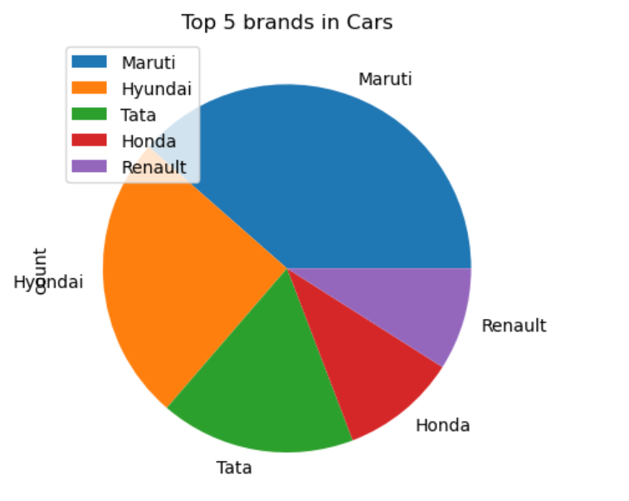
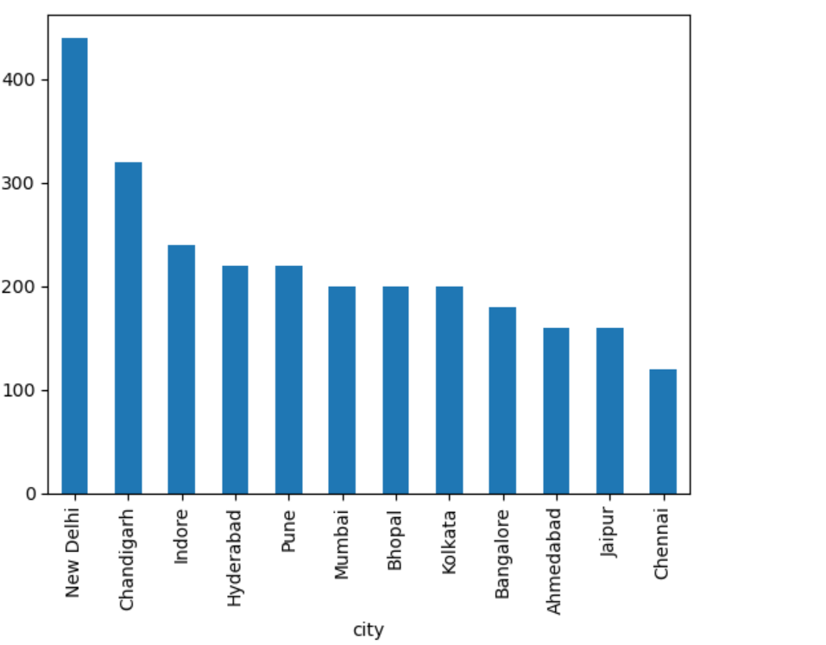
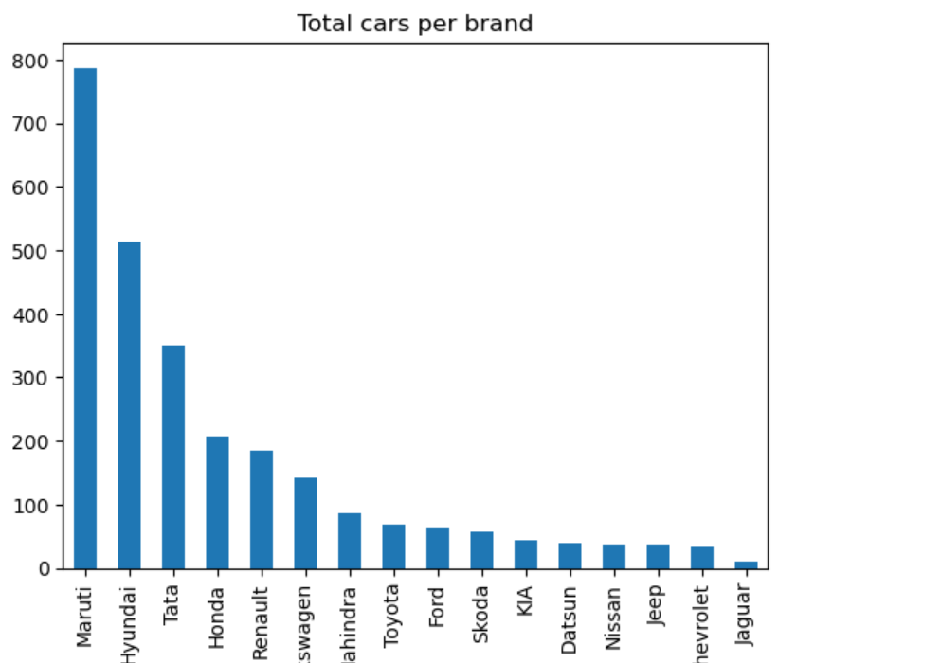
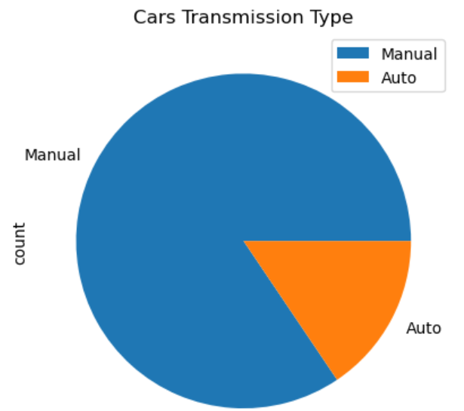
Univariate Analysis

Slide 10
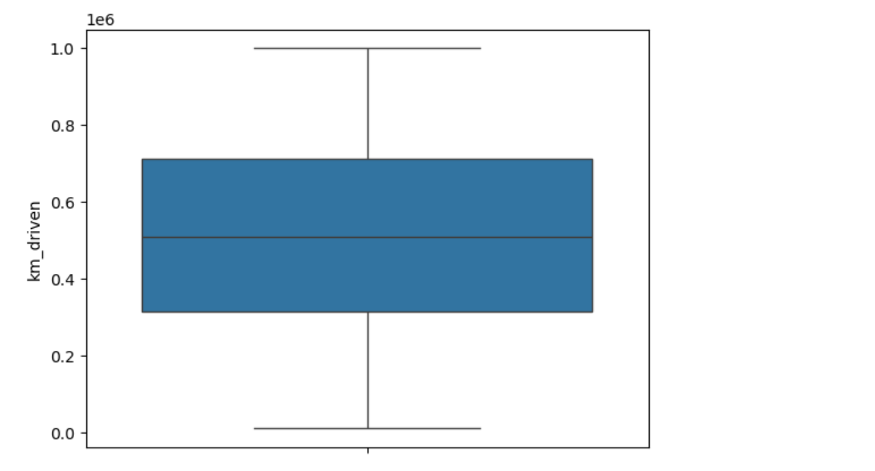
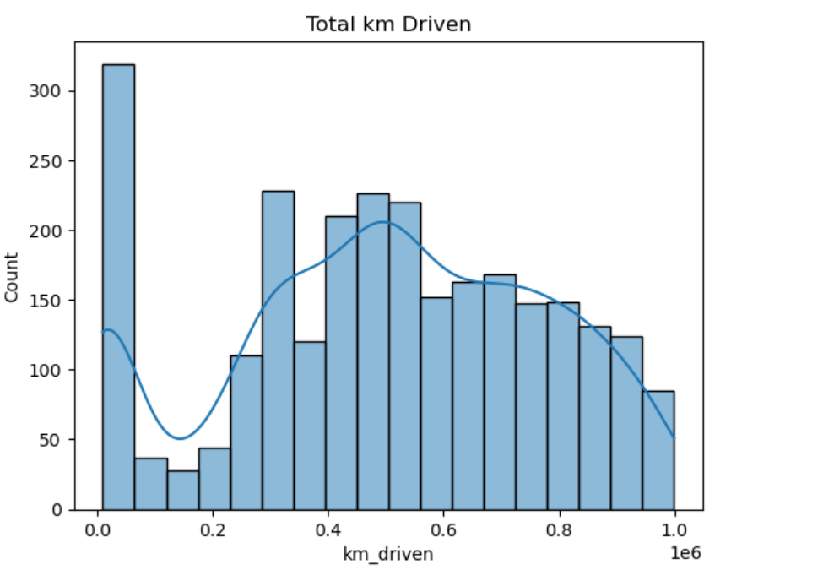
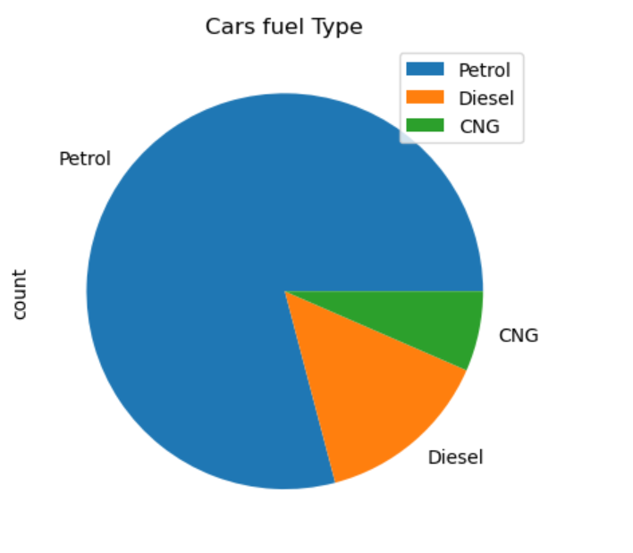
Univariate Analysis

Slide 11
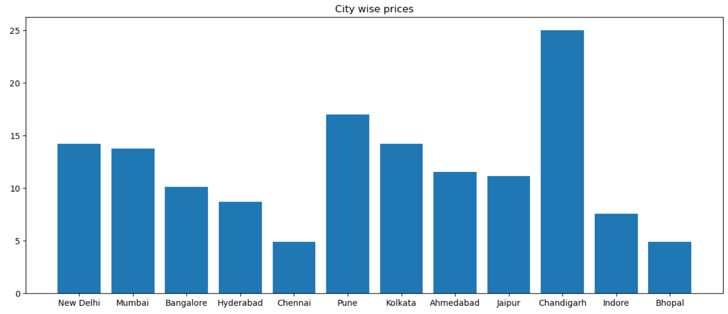
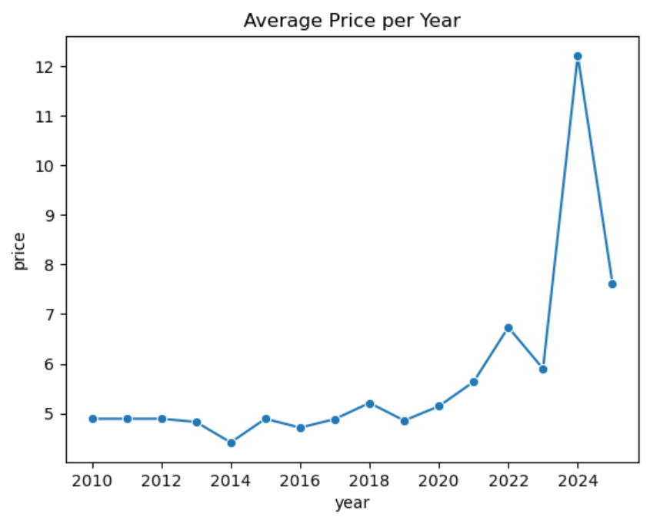
BI-Variate Analysis

Slide 12
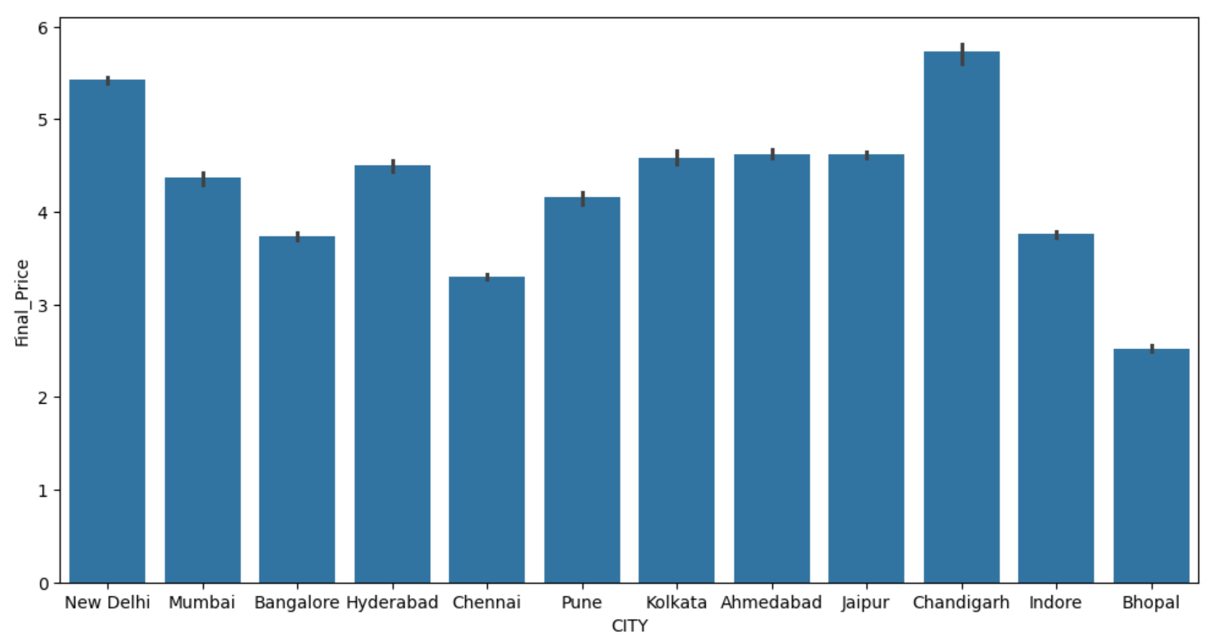
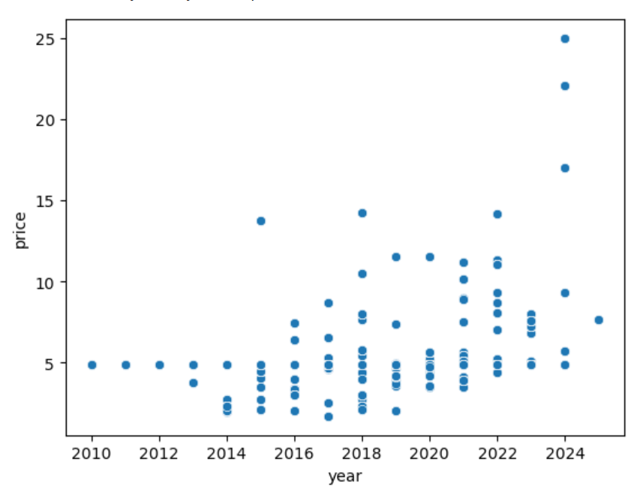
BI-Variate Analysis

Slide 13
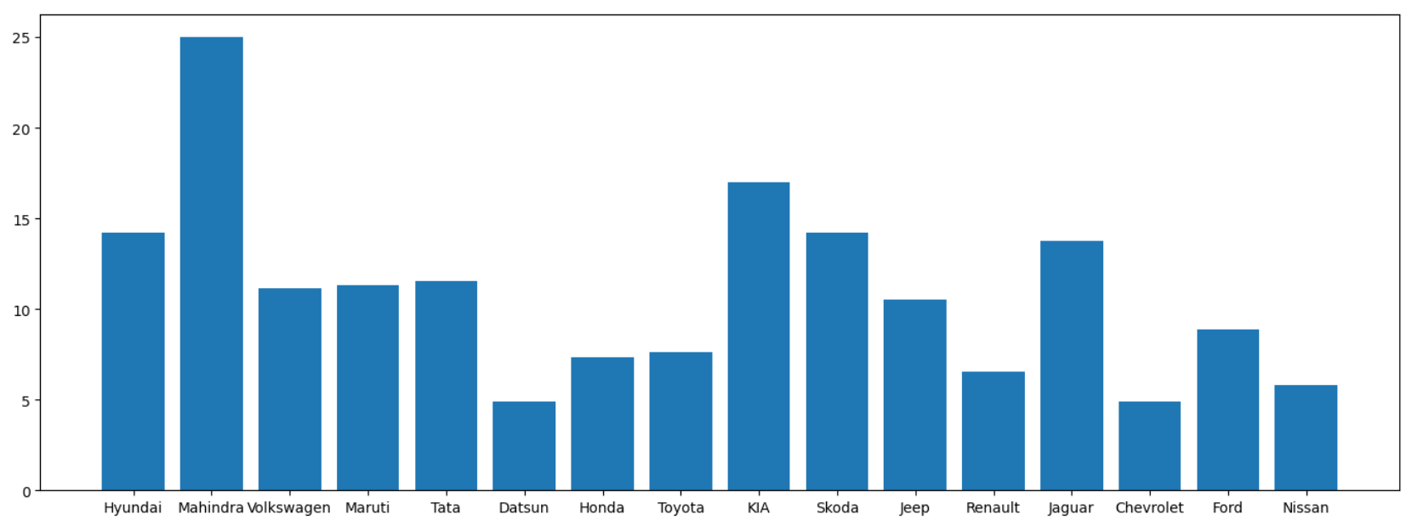
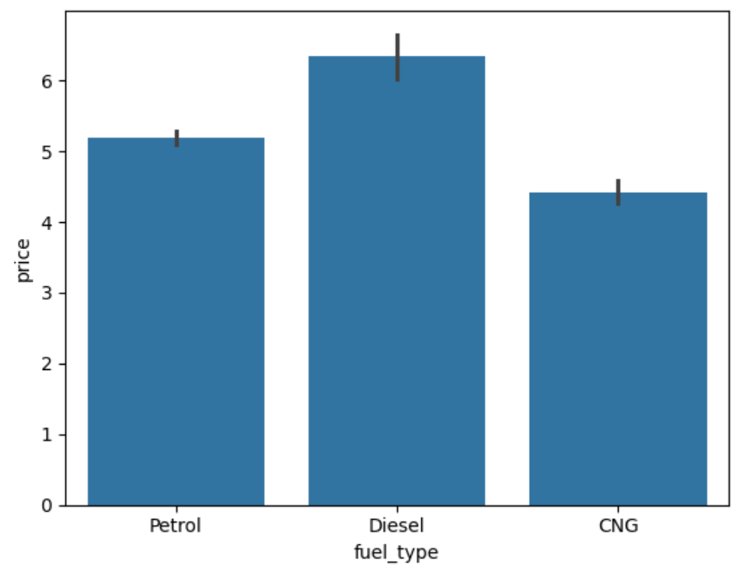
BI-Variate analysis

Slide 14
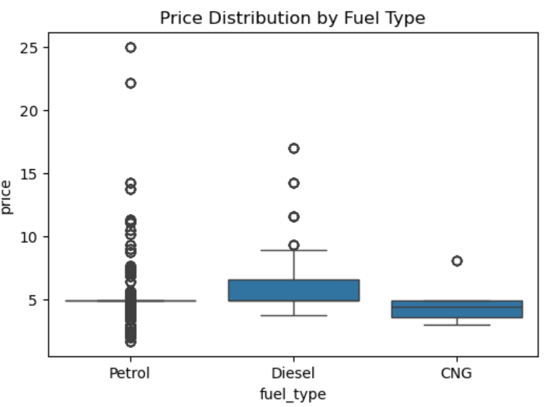
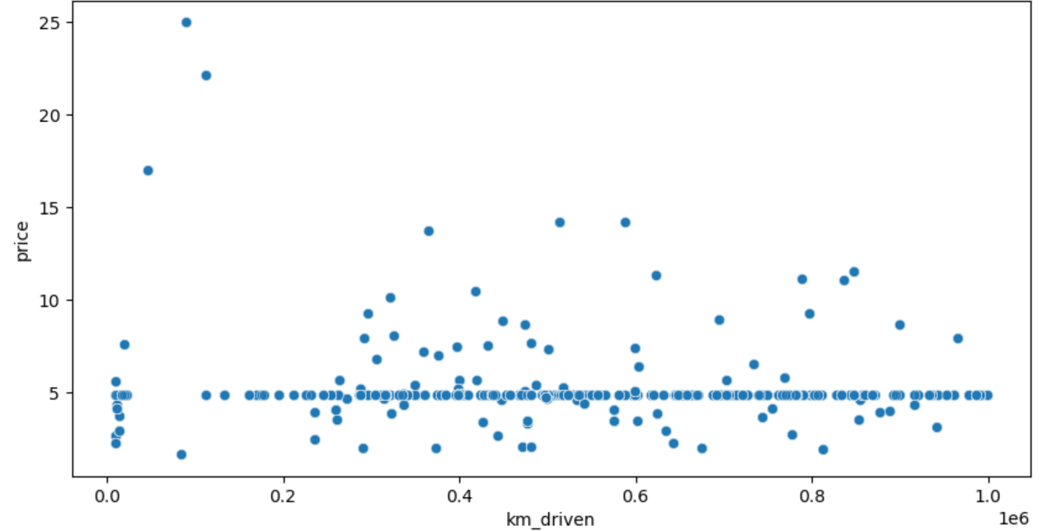
BI-Variate Analysis

Slide 15
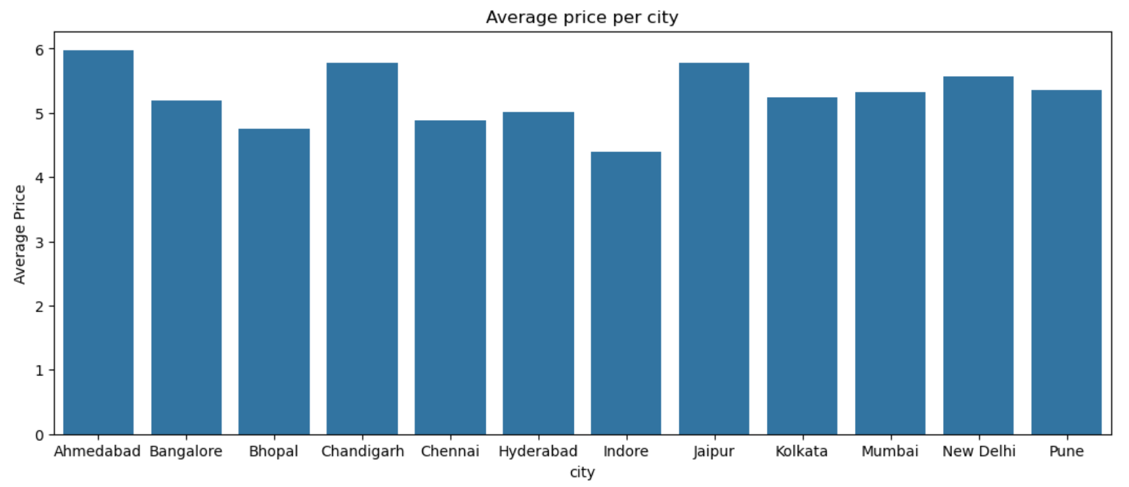
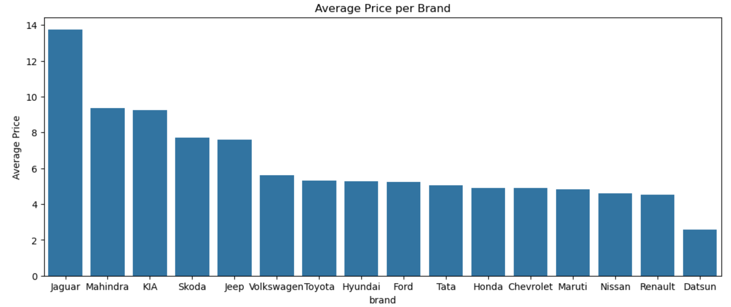

Slide 16
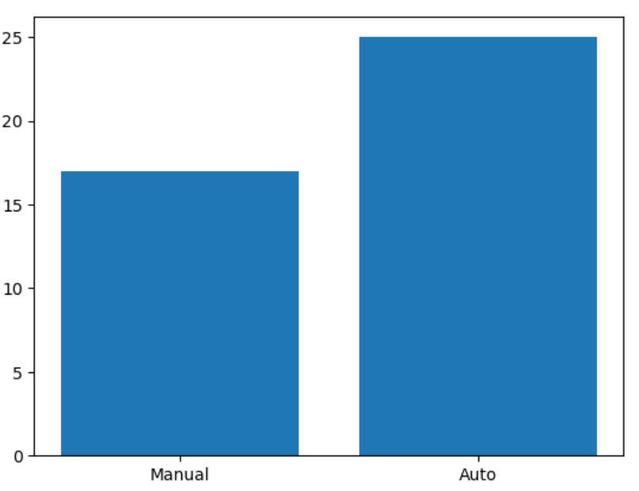
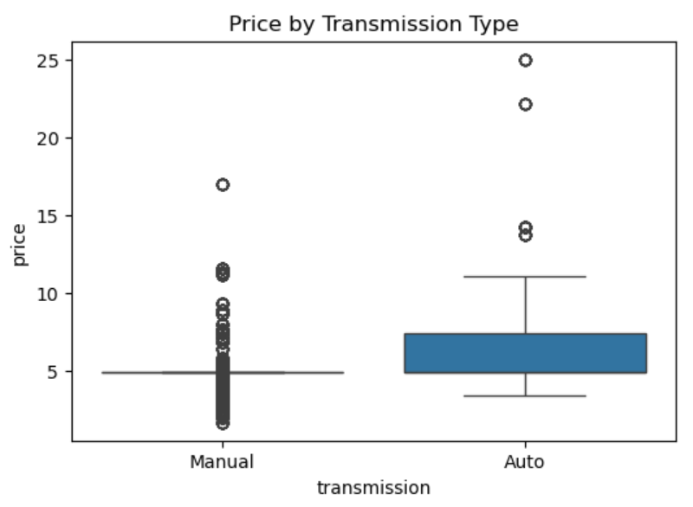
BI-Variate Analysis

Slide 17
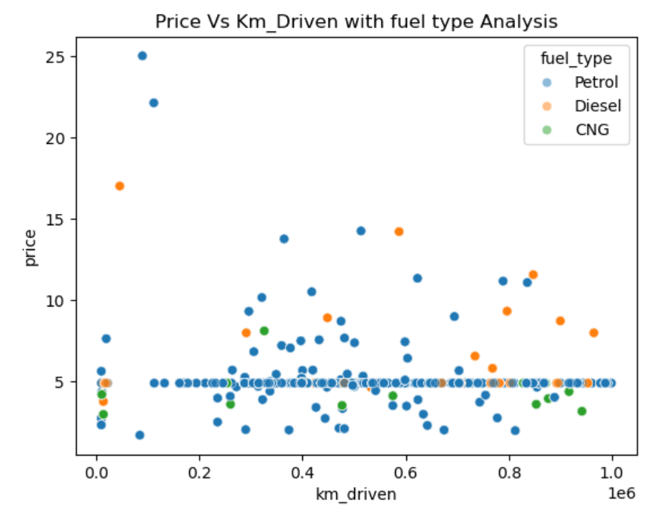
Multi Variate Analysis

Slide 18
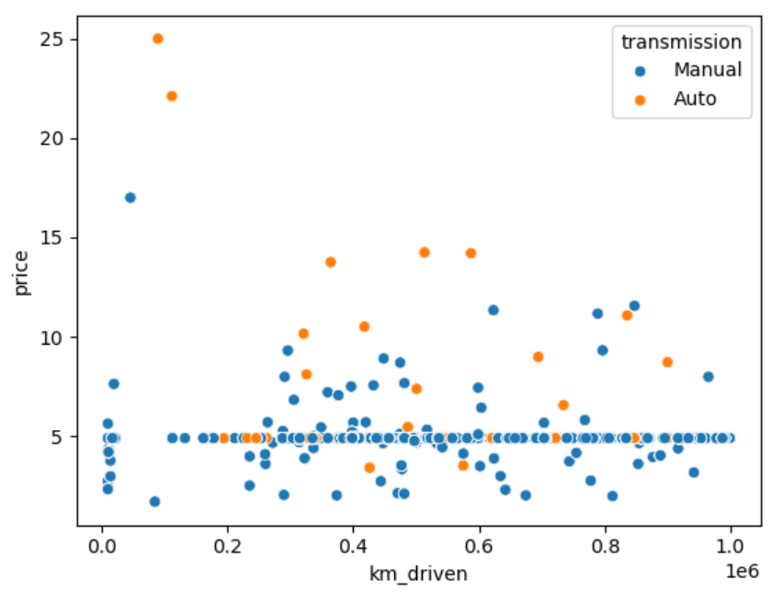
Multi Variate Analysis

Slide 19
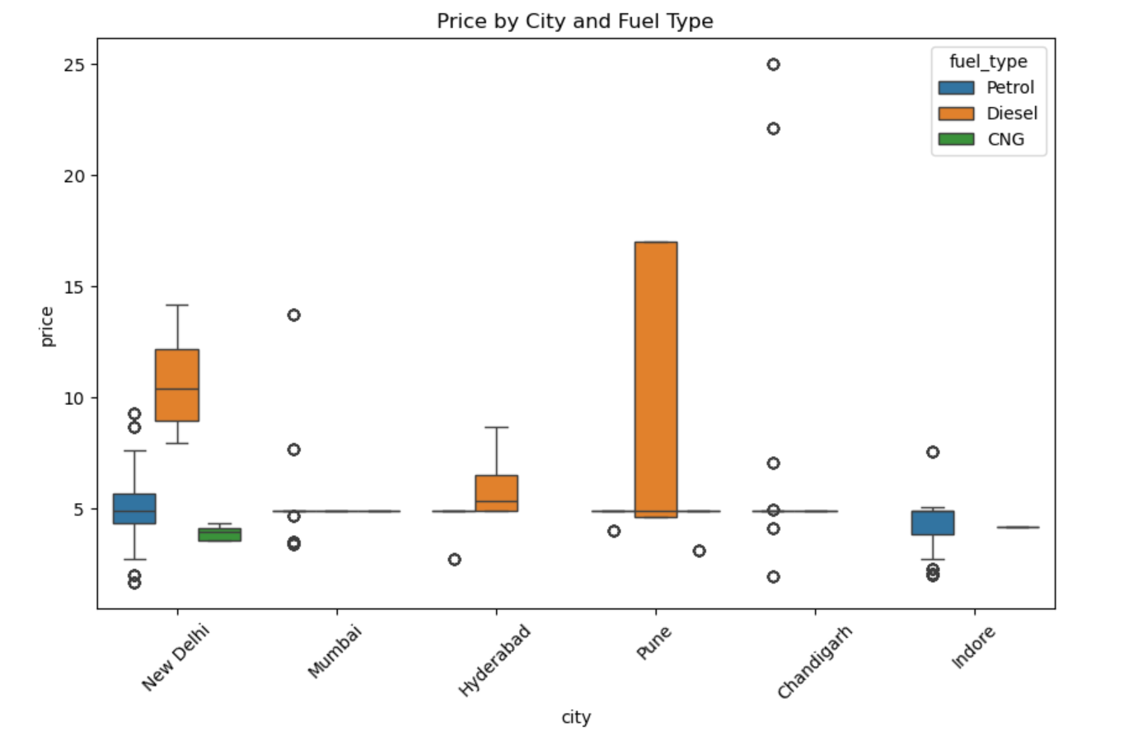
Multi Variate Analysis

Slide 20
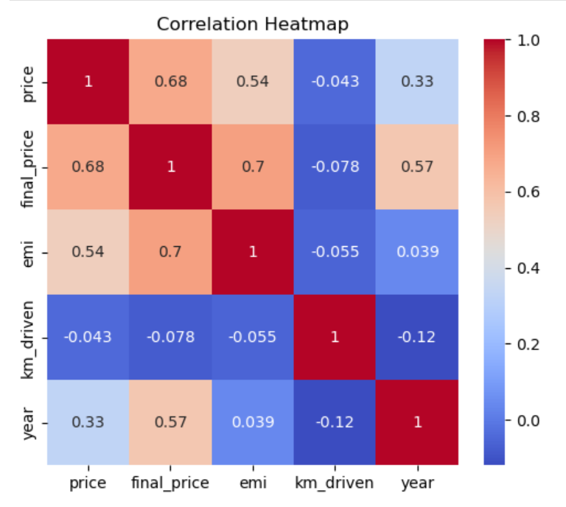
Multi Variate Analysis

Slide 21
Key Business Questions
What factors most influence used-car resale prices?
How do vehicle age and kilometers driven affect price depreciation?
Do fuel type and transmission type impact resale value?
How does pricing vary across different cities?
Which brands retain higher resale value in the used-car market?

Slide 22
INSIGHTS
Key Factors Affecting Used-Car Prices
Used-car resale prices are mainly influenced by manufacturing year, EMI, fuel type, transmission, and city.
The correlation analysis shows:
  Price vs EMI = 0.54 (moderate positive relationship)
  Final Price vs EMI = 0.70 (strong relationship)
  Price vs Year = 0.33 (newer cars generally cost more)
This shows that financial and vehicle characteristics together drive pricing.
EMI as an Affordability Indicator
As the car price increases, EMI also increases.
The strong correlation (0.70) between final price and EMI shows that:
  EMI can be used as a reliable indicator of affordability and price level.

Slide 23
INSIGHTS
Impact of Vehicle Age & Mileage
Newer cars tend to have higher resale prices, but the relationship is not perfect.
Mileage (KM Driven) does not show a strong linear relationship with price
(Price vs KM Driven = –0.043).
Most cars are driven between 35,000 km and 75,000 km, with an average around 50,000 km.
High-priced cars (₹15+ lakhs) are usually driven below 20,000 km.
Cars priced between ₹5–10 lakhs are mostly driven 20,000–60,000 km.
Mileage affects price in a non-linear way, especially at higher usage levels.

Slide 24
INSIGHTS
City-Wise Pricing Trends
New Delhi has the highest number of used-car listings, making it the most active market.
The top 5 cities each sell more than 150 cars.
Most cities have an average resale price above ₹5 lakhs.
Chandigarh shows the highest average prices, mainly due to a few high-price outliers (₹20+ lakhs).
City-specific patterns:
New Delhi: Over 50% diesel cars priced above ₹8 lakhs; petrol cars mostly ₹4–6.5 lakhs.
Hyderabad: Diesel cars dominate, mostly priced above ₹5 lakhs.
Mumbai: Limited data, prices range from below ₹5 lakhs to ₹15 lakhs.
Indore: Mostly petrol cars priced below ₹5 lakhs.

Slide 25
Brand-Wise Insights
Maruti is the most listed brand (~545 cars), followed by Hyundai and Tata.
Premium brands like Jaguar, Kia, and Mahindra have average prices above ₹15 lakhs.
Skoda and Jeep fall into the mid-price segment (₹6–6.5 lakhs).
Popular brands sell more, but premium brands retain higher resale value.
Fuel Type & Transmission Insights
Fuel Type
Petrol cars dominate the market (more than 75%).
Diesel cars are second most common and mostly priced ₹5–10 lakhs.
CNG cars are very limited and mostly priced below ₹5 lakhs.
Transmission
Manual cars dominate by volume (65–75%).
Automatic cars are priced higher on average.
Manual cars are mostly below ₹5 lakhs.
Automatic cars show high-price outliers (₹20–25 lakhs)

Slide 26

THANK YOU

